Slide 1

AI Inventory Optimizer – Capstone Project Blueprint
Smarter Ordering & Product Recommendations for Convenience/ Retail Stores
Yasmin Bello
Larry Towett
Milagros Pumasupa
Ahad Maredia

Slide 2
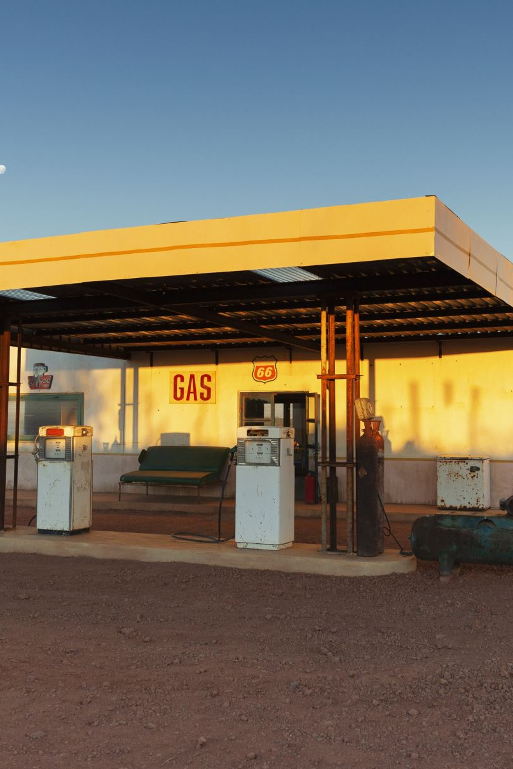
Problem Statement
Convenience/gas station stores often:
Overstock items → wasted capital & expired goods
Understock high-demand items → lost sales
Struggle to identify trending products quickly
Goal: Build an AI system to predict order quantities and recommend new products

Slide 3

Objectives
1. Demand Forecasting – Predict weekly demand for each product
2. Product Recommendations – Suggest trending/new items
3. Dashboard Demo – Upload sales data → Actionable insights

Slide 4
Technical Approach
Demand Forecasting: LSTM/GRU, XGBoost/RandomForest
Inputs: Sales history, holidays, seasonality, product metadata
Outputs: Predicted sales → order recommendations
Product Recommendation: Content-based + Collaborative filtering
Outputs: Top N new products to consider

Slide 5
Datasets
Walmart Sales Forecasting
Favorita Grocery Sales Forecasting
Rossmann Store Sales
Retail/Market Basket datasets

Slide 6

Tools & Tech Stack
AI/ML: TensorFlow/Keras, Scikit-learn
Recommendation Systems: LightFM, Surprise
Data Handling: Pandas, NumPy
Visualization/Dashboard: Streamlit, Plotly, Matplotlib

Slide 7
Workflow
1. Collect & clean past sales data
1
2. Feature engineering (dates, holidays, product metadata)
2
3. Train demand forecasting models
3
4. Train recommendation models
4
5. Build Streamlit dashboard for demo
5

Slide 8
Timeline & Milestones
Weeks 1–2: Team formation, finalize proposal
Weeks 3–4: Data collection & preprocessing
Weeks 5–7: Model development
Weeks 8–9: Integration & dashboard building
Weeks 10–11: Testing & refinement
Week 12: Final submission (Dec 6, 2025)

Slide 9
Success Metrics
Forecasting accuracy → RMSE/MAE
Recommendation quality → Precision@K, Recommended items Recall@K (relevant items that should have been recommended)
Dashboard usability → User feedback

Slide 10
Risks & Mitigation
Data availability → Kaggle datasets as fallback
Model accuracy → Compare multiple models
Overcomplexity → Start with MVP first

Slide 11
Ethical Considerations
Avoid
Avoid bias toward big brands
Ensure
Ensure transparency in predictions
Respect
Respect data privacy when using customer/multi-store data

Slide 12
Why It Works as a Capstone
Real-world relevance → Retail & supply chain
Interdisciplinary → Time-series + recommendation systems
Scalable → Can evolve into SaaS
Reproducible → Public datasets, open-source tools

